Slide 1

Module 3.2
Time and Space Management
Montana Teen Driver Education and Training
A Systematic Approach
Notes:
Managing time and space helps us develop situational awareness. It helps us understand the context of what is happening with other HTS users and the various obstacles we encounter on every drive.
The purpose of a space and time management system is to help the user develop a systematic approach to understanding the driving task. Novice drivers don’t know how to search, don’t know where to look or what to look for and then what to do with any information they have gathered. Our goal in teaching time and space management then, is to help the novice driver become a critical thinker and sophisticated problem solver dealing with the numerous problems that arise when driving.

Slide 2
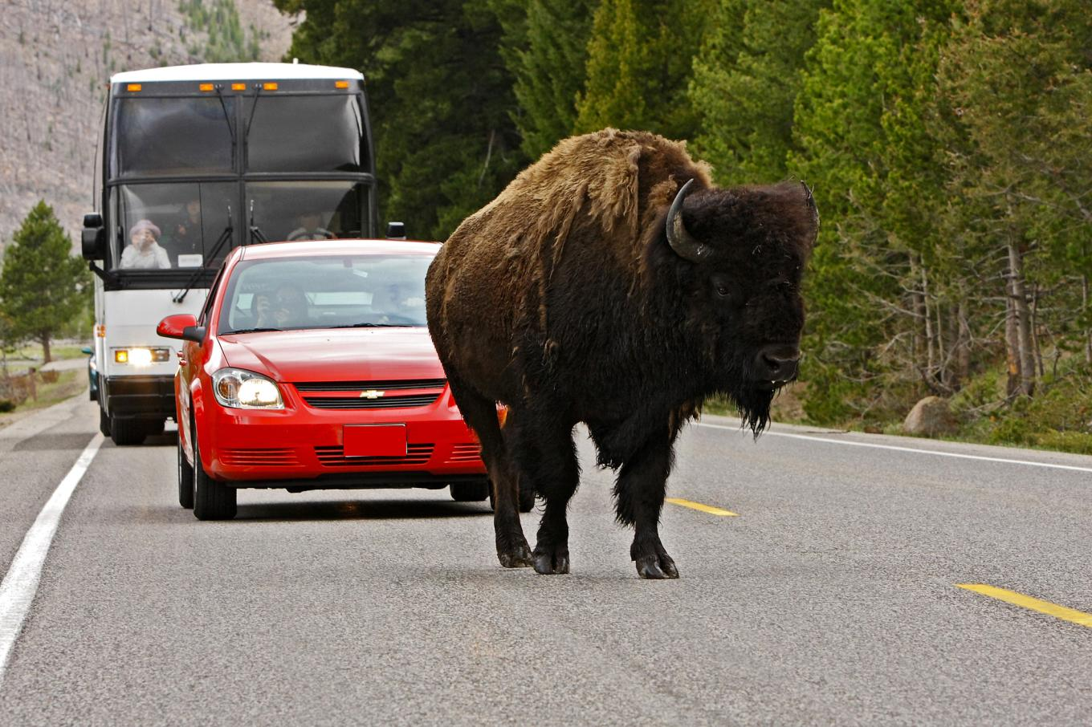
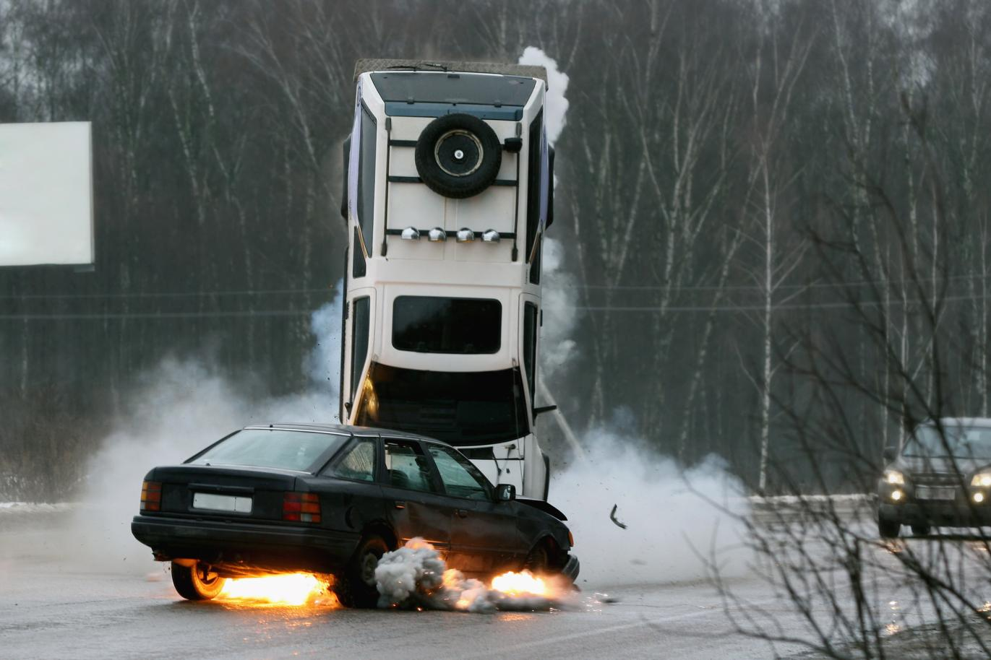
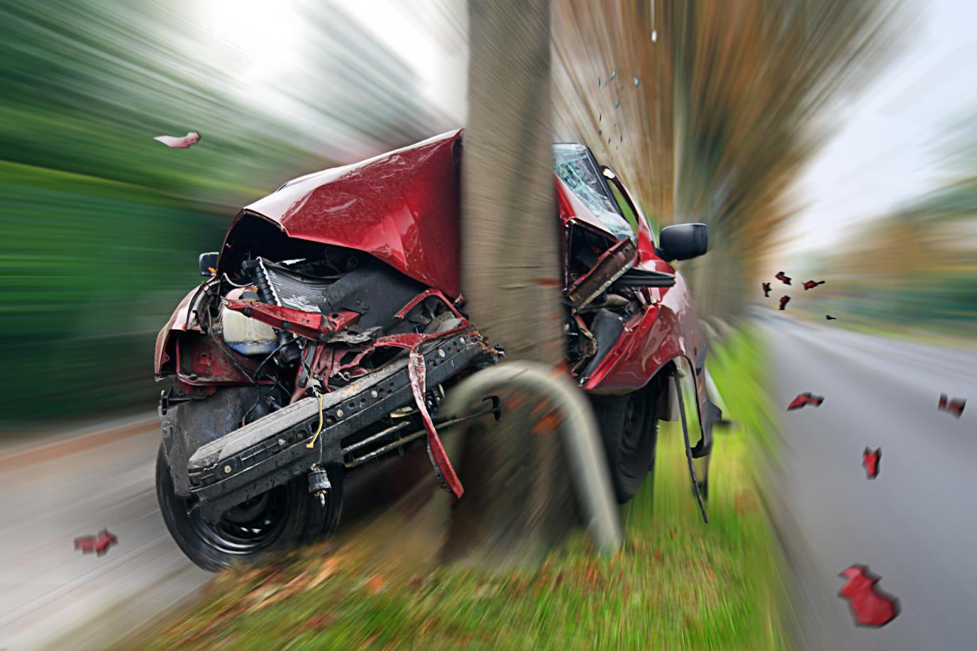
Two Objects - Same Space
Notes:
The laws of physics say that two objects cannot occupy the same space simultaneously. That has a lot of implications for driving. Crashes are a result of two or more vehicles trying to occupy the same space at the same time.
So, what is the best way to minimize the chances of two cars or objects trying to occupy the same space at the same time?

Slide 3
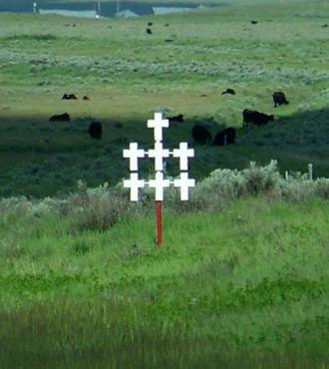
A Sad Reminder of
Mismanaged Space
Notes:
Montanans have a constant reminder of the consequences of mismanaged space and mismanaged vehicle balance. Use this as an opportunity to remind students that driving is a serious task and that there is no reset button in this game of life.

Slide 4
How can I manage time and space around my car to keep me safe and prevent a crash?
Notes:
Module key question. Every driver needs to manage time and space around their vehicle so they can reduce the risk of crashes and manage the risk created by moving objects.

Slide 5
Zone Control System for Space Management©
Frederik R. Mottola©2013. Permission granted to Montana OPI.
Notes:
There are five different space management systems that can be used to teach driving.
These are examples of previous systems and not intended that all should be taught to the students. Too much information means too much confusion for the students. For the sake of consistency the decision to use one system—The Zone Control System—was made by the curriculum team. OPI has permission to use the ZCS so long as it is not altered or changed from the author’s original language or intent.
The oldest is the Smith System
Aim High in steering
Get the big picture
Keep your eyes moving
Leave yourself an out
Make sure they see you.
SIPDE Used in Responsible Driving
Search the roadway and the off-road areas for roadway, vehicle, and other user information that can help plan
the path of travel at 20 to 30 seconds ahead of the vehicle.
Identify objects or conditions that could threaten the intended path of travel. Is the risk situation, a potential or
immediate threat for an unwanted consequence?
Predict what threats or changes in conditions could increase or decrease the level of threat to the planned
path of travel.
Decide what speed control or lane position action would reduce the threat of a collision consequence.
Execute the decision by appropriate communication, followed by a speed and/or position adjustment
IPDE Used in Drive Right
Identify problems to give meaning to what is seen. The sooner a potential or critical hazards in the roadway
are identified, in the vehicle, or due to other users; the more time will be available to react safely to the critical
hazard.
Predict how the potential or immediate hazard might affect the intended path of travel.
Decide upon a minimize, separate, or compromise maneuver to reduce the hazard critical to the path of travel.
Execute the decision with precision speed control, lane position and communication.
SAFE Used in License to Drive
Scan to gather as much information as possible about the complete driving scene around the vehicle.
Assess potential threats in the driving environment.
Find a way out of the situation.
Execute the decision to avoid upcoming conflict by changing speed and/or changing direction.
ABCs Used in Drive Right and Mottola’s Zone Control
Alert switch is turned on by seeing a LOS POT blockage to your path of travel.
Before acting, check other zones for options.
Create time and space management, get the best speed, the best lane position, communicate.
An open zone is a space where the vehicle can be placed without a restriction to the line of sight or intended
path of travel.
A closed zone is space is unavailable for vehicle placement due to a restriction in the line of sight or intended
path of travel.
A changing zone is a worsening condition, an open zone changing to closed zone, or a closed zone with an
additional restriction.
Reduced-risk decisions are performed by developing visual skills to make critical adjustments of speed and/or
lane position into open space with adequate time for adjustments
SEE Used in the ADTSEA and some State Model Curriculum Guides
Some states have created their own acronym for a space management system. The most common is SEE.
Search the intended path of travel and space to the rear for problems and restrictions to the sightline or
intended travel path.
Evaluate open spaces to front, side, and rear to determine reduced-risk adjustments for speed or lane
position.
Execute reduced-risk adjustments by visually targeting new path of travel, visually check mirrors, give
appropriate communication, adjust speed, then adjust lane position.

Slide 6
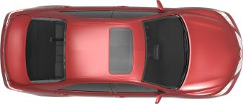
Six Zones Around a Car
Right Front
Right Rear
Front
Rear
Left
Front
Left
Rear
Frederik R. Mottola©2013. Permission granted to Montana OPI.
Notes:
The zone control system divides the space around a car into 6 zones as indicated on the PPT slide. You see that there are three in the front and three in the back.
The car is in the middle of those 6 zones and the driver manages the space the car is traveling into by determining if the space is open or closed or changing. See the next slide for an explanation of open or closed.

Slide 7

A zone can be open, closed or unstable
Frederik R. Mottola©2013. Permission granted to Montana OPI.
Notes:
Open Closed demonstration
Go to the classroom door and open it. Ask the students the condition of the doorway. Ask what they can do with an open door.
Close the door and ask the same question. State the condition of the door and what they can do at that moment.
What happens when the door is closing or opening? Hint: it is a unstable zone and therefore either prevents you from using it or it opens up and you can use it.
The three conditions of Zones:
Open
Closed
Unstable

Slide 8
What makes a zone closed?
Line-of-Sight (LOS) blockages
Path-of-Travel (POT) blockages
Student Activity 1 (three minutes)
  Working in groups make a list of things that block your view and prevent you from gathering critical information when driving.
  Make a list of things that might block your path and prevent you from driving in that place.
Frederik R. Mottola©2013. Permission granted to Montana OPI.
Notes:
What is a Line-of-sight blockage?
Any object (car, truck, plant, fence, house, etc.) that blocks my ability to gather critical information that I need to drive safely
What is a Path-of-travel blockage?
Anything in my path or near my path that blocks my ability to drive there.

Slide 9

Searching Ranges
Target Area
Target Area
15-20 Second Range
Four-Second Danger Zone
15-
Second Range
4-Second Danger Zone
Frederik R. Mottola©2013. Permission granted to Montana OPI.

Slide 10
The Zone Control System©
Find
Solve
Control
Frederik R. Mottola©2013. Permission granted to Montana OPI.

Slide 11
FIND
What Line-of-Sight (LOS) blockages prevent me from gathering critical information?
What Path-of-Travel (POT) blockages prevent me from going into a specific space?
“Focus on the Relevant”
What is important at this moment to me driving safely?
Frederik R. Mottola©2013. Permission granted to Montana OPI.
Notes:
The first step in the Zone Control system is to use good searching strategies to find the LOS-POT blockages that will cause a zone closure.

Slide 12
FIND: Student Activity 2
Look at the following slides.
Find the LOS-POT blockages and the zones in which they occur.
Frederik R. Mottola©2013. Permission granted to Montana OPI.
Notes:
Over the next several slides the student is to search using the three searching ranges and identify the LOS and POT blockages they see in the photos. They can get pretty detailed but the important items for them to notice are those that will impact their path or ability to gather critical information.

Slide 13
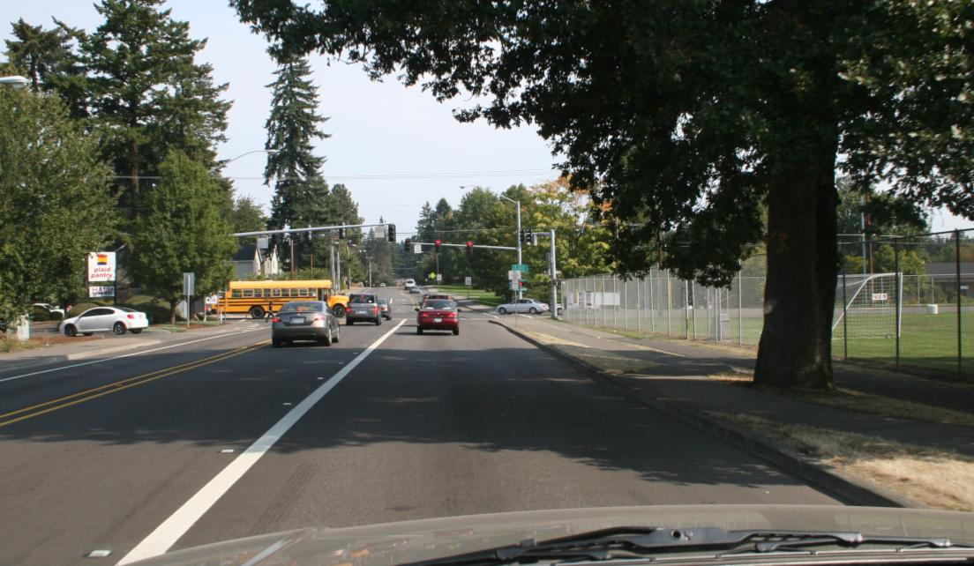
FIND: Line-of-Sight and
Path-of-Travel Blockages
What LOS or POT blockages do you see?
What zones are blocked? Which are open?
Frederik R. Mottola©2013. Permission granted to Montana OPI.
Notes:
POT blockages
The stopped cars in my lane
The red traffic light.
The curb on the right
The white barrier line on the left.
LOS Blockages
The tree on the right
The bus ahead and on the left

Slide 14
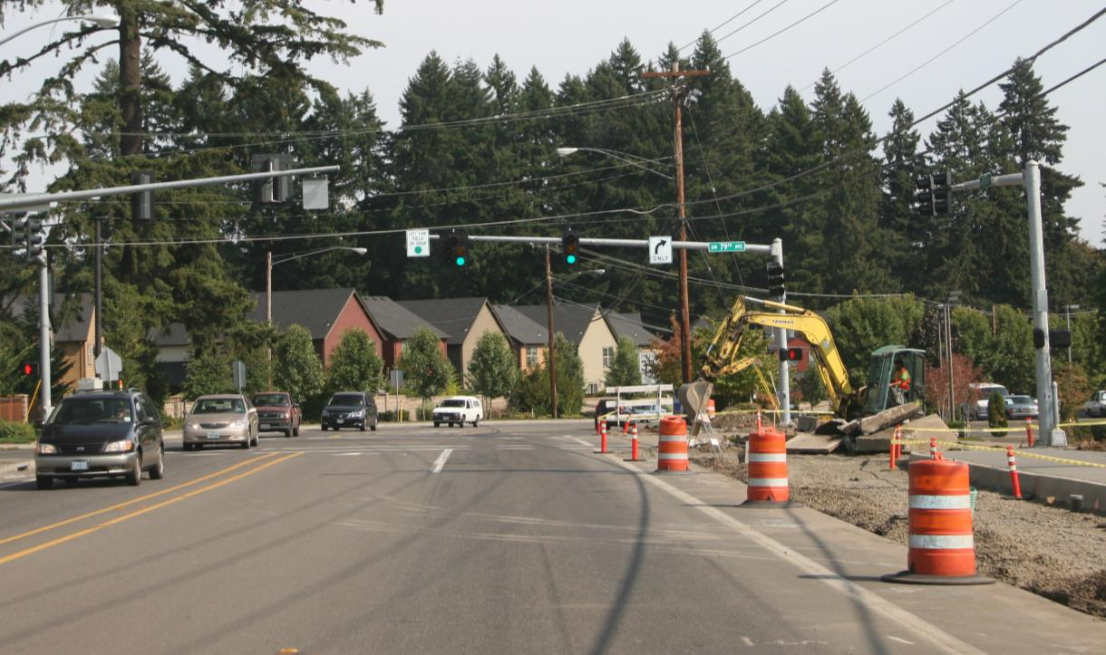
FIND: LOS and POT Blockages
What LOS or POT blockages do you see in your right front zone? How is your front zone?
Frederik R. Mottola©2013. Permission granted to Montana OPI.
Notes:
The right front zone is closed because of the construction barrels and uneven shoulder created by the construction.
The front zone is closed by the curve in the road and the construction barrier next to the back hoe creates a LOS blockage so we can’t see through the curve.
The front zone has a LOS blockage created by the curve and the construction backhoe.
The front zone is unstable because we don’t know how long the light has been green and therefore might change to red.

Slide 15
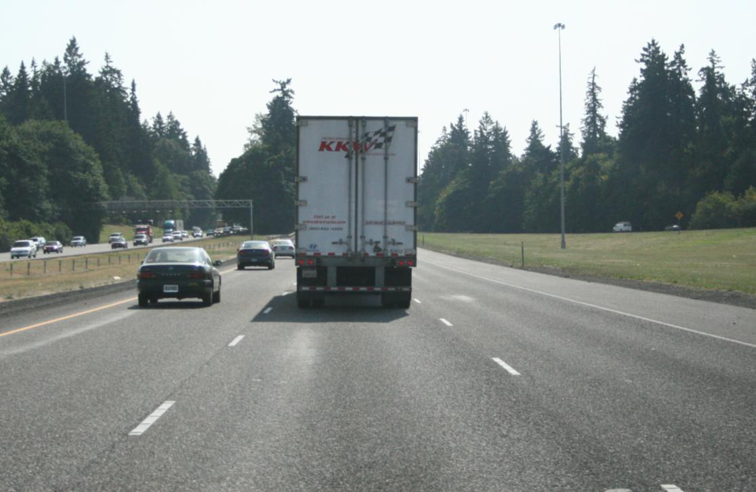
FIND
How is your front zone?
Frederik R. Mottola©2013. Permission granted to Montana OPI.
Notes:
Front zone is blocked with both POT and LOS because of the truck.
The open zone is the right front zone.
This is getting ahead of ourselves but you might want to ask the following questions?
Did you see the cars coming onto the freeway on the right?
Do you think the truck is going to pull over to the right lane? Why or why not?
Is it a good idea to pass the truck on the right?
Trucks have an area around them called the “NO-Zone.” What do you think that means?

Slide 16
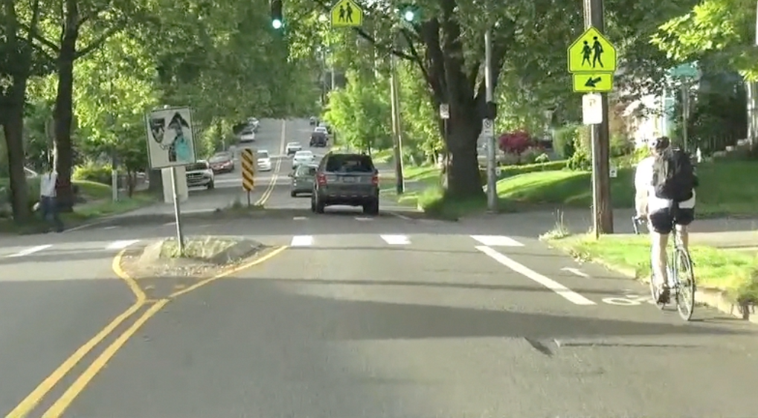
FIND
How is your right front zone? How is your left front zone?
Frederik R. Mottola©2013. Permission granted to Montana OPI.
Notes:
You are about to pass this cyclist.
Does he make your right front zone closed? Why or why not? Remember the definition of a closed zone.
What about your left front zone? What happens to the roadway at the intersection?
If you try to pass the cyclist at the intersection what happens to your space at the intersection?
What happens to the roadway after the intersection?
Where do you think the best place is to pass this cyclist?

Slide 17
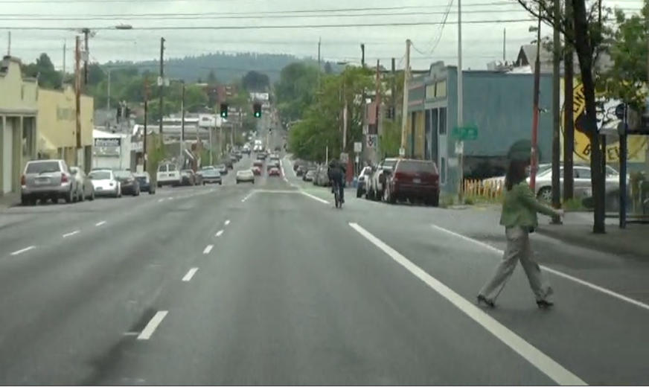
FIND
How is your right front zone?
How is your left front zone?
Frederik R. Mottola©2013. Permission granted to Montana OPI.
Notes:
Your right is closed by two people. Even though the pedestrian is crossing the street mid-block she still presents a closed right front zone. The cyclist also closes your right front zone.
Your left front zone is open so you do have space to move there if you need. What other zone might be of concern to you if you were considering a lane change to make space?
What does the wide solid white line mean for you on the right side of the road? Does it also close your right front zone?

Slide 18
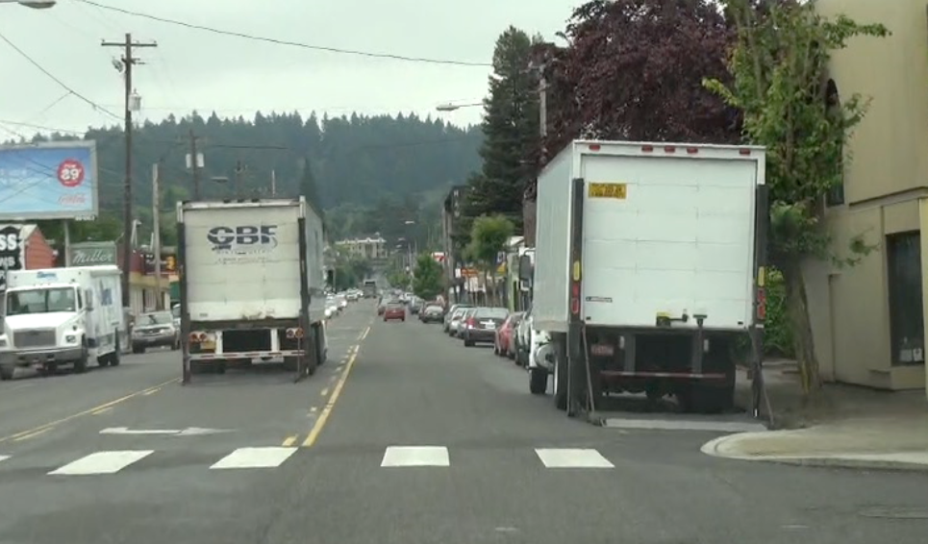
FIND
How is your right front zone?
How is your left front zone? How is your front zone?
Frederik R. Mottola©2013. Permission granted to Montana OPI.
Notes:
LOS and POT

Slide 19
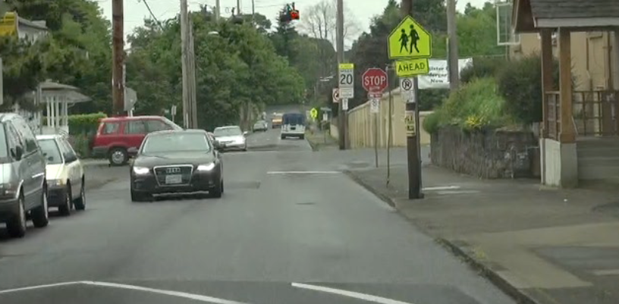
FIND
How is your front zone? How is your left front zone?
Frederik R. Mottola©2013. Permission granted to Montana OPI.
Notes:
There are many LOS and POT blockages in this photo
POT
Stop sign
Speed hump
Car coming at you
Intersection
Parked bus on the other side of the intersection
LOS
Cars on your left
Building on your right

Slide 20
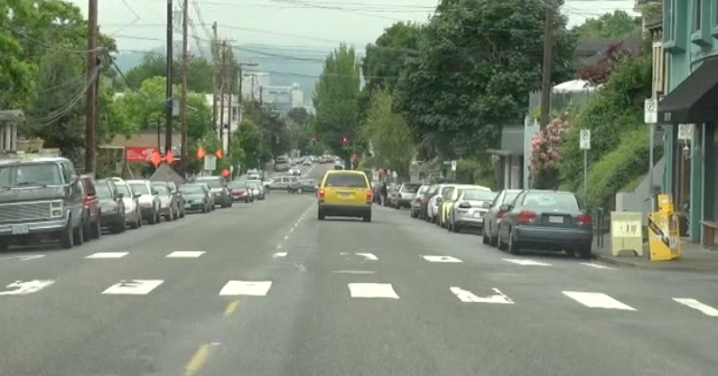
FIND
How is your front zone?
How is your target area?
Frederik R. Mottola©2013. Permission granted to Montana OPI.

Slide 21
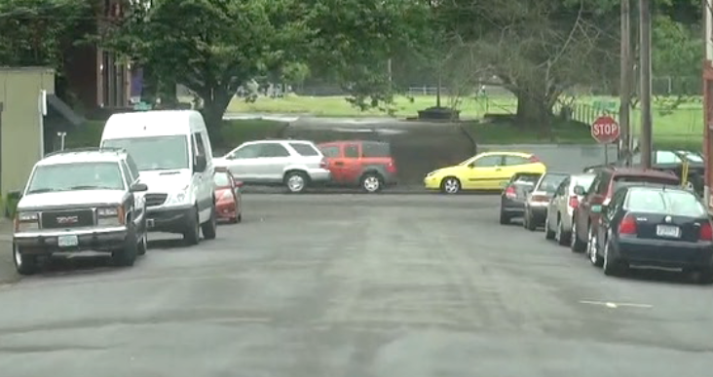
FIND
How is your front zone?
How is your target area?
Frederik R. Mottola©2013. Permission granted to Montana OPI.

Slide 22
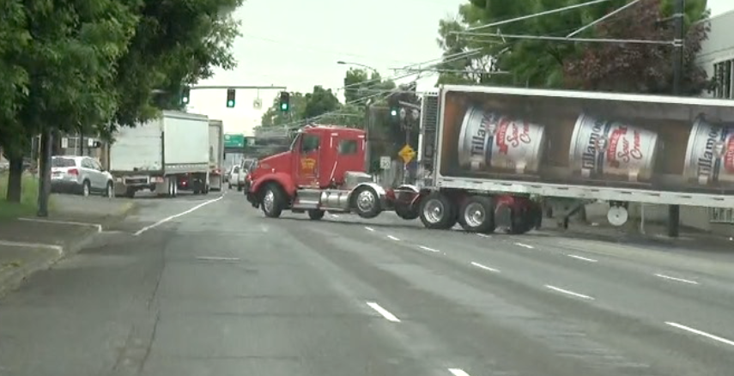
FIND
What LOS POT blockages do you see? How is your left front zone? How is your target area?
Frederik R. Mottola©2013. Permission granted to Montana OPI.

Slide 23
SOLVE
Before acting, check the condition of the related zone or zones.
Determine the actions you will take.
It’s all about creating time and space and having some place to safely move into.
Frederik R. Mottola©2013. Permission granted to Montana OPI.
Notes:
The next step in the zone control system is to SOLVE for LOS POT blockages by checking the related zones. The related zones are those that are opposite the blocked or closed zone. We check those because we may need to move into those zones to create space between us and the blocked zone.

Slide 24
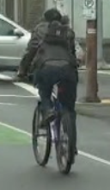

Six Zones Around a Car
Right Front
Right Rear
Front
Rear
Left
Front
Left
Rear
Frederik R. Mottola©2013. Permission granted to Montana OPI.
Notes:
If a zone is closed the driver should check the related zone or zones to make sure they have a place to go to create space.
If the front is closed by a stop sign then the driver would check the rear zone.
If the right front zone is closed by a bicyclist on then the driver would check actually two zones. The left front because it is opposite and the driver may need to move to LP 2 or 4 to create space and the left rear in case the driver needs to move to the left to avoid the cyclist .

Slide 25
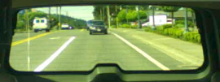
SOLVE: Line-of-Sight and
Path-of-Travel Blockages
What other zones should you check and
what are their conditions?
Frederik R. Mottola©2013. Permission granted to Montana OPI.
Notes:
POT blockages
The stopped cars in my lane
The red traffic light.
The curb on the right
The white barrier line on the left.
LOS Blockages
The tree on the right
The bus ahead and on the left

Slide 26
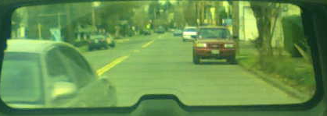
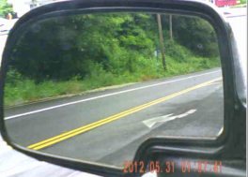
SOLVE: LOS and POT Blockages
What other zones should you check and
what are their conditions?
Frederik R. Mottola©2013. Permission granted to Montana OPI.
Notes:
The right front zone is closed because of the construction barrels and uneven shoulder created by the construction.
The front zone is closed by the curve in the road and the construction barrier next to the back hoe creates a LOS blockage so we can’t see through the curve.
The front zone has a LOS blockage created by the curve and the construction backhoe.
The front zone is unstable because we don’t know how long the light has been green and therefore might change to red.

Slide 27
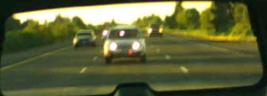
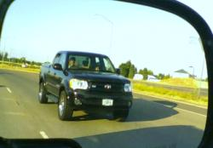
SOLVE
What zones should you check?
Are they open or closed?
Frederik R. Mottola©2013. Permission granted to Montana OPI.
Notes:
The student should solve the blocked LOS and POT created by the truck by checking the rear zone, the right front zone and right rear zone. They may also want to check the left rear zone to look for an opportunity to move into the far left lane.
The rear is closed, the right rear is closed and the right front is closing by the traffic about to come onto the free.

Slide 28
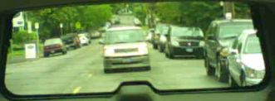
SOLVE
What other zones should you check?
What is the condition of those zones?
Frederik R. Mottola©2013. Permission granted to Montana OPI.
Notes:
You should check your rear zone to see if you have space to slow down.

Slide 29
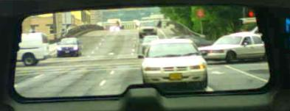
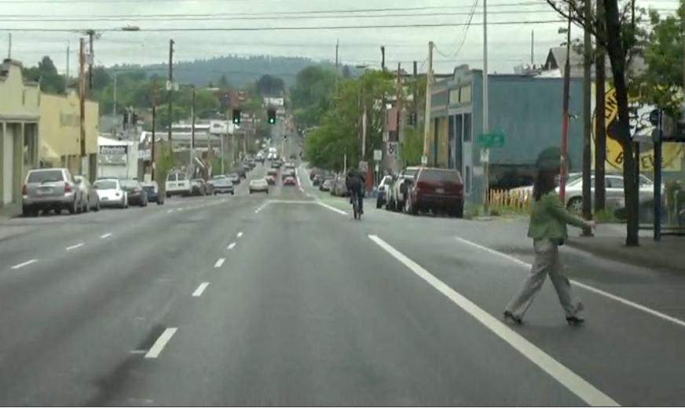
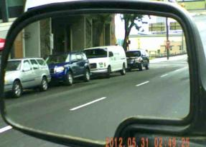
SOLVE
What other zones should you check?
What is the condition of each zone?
Frederik R. Mottola©2013. Permission granted to Montana OPI.
Notes:
Your right is closed by two people. You need to check your rear zone in case you need to stop.
You need to check your left front and your left rear to make sure you can move into LP 2 or make a move to LP 4.
They are both open so you have the option to move to those lane positions.
What else must you do to ensure that your left rear zone is open?
Do an over the shoulder check to the left.

Slide 30
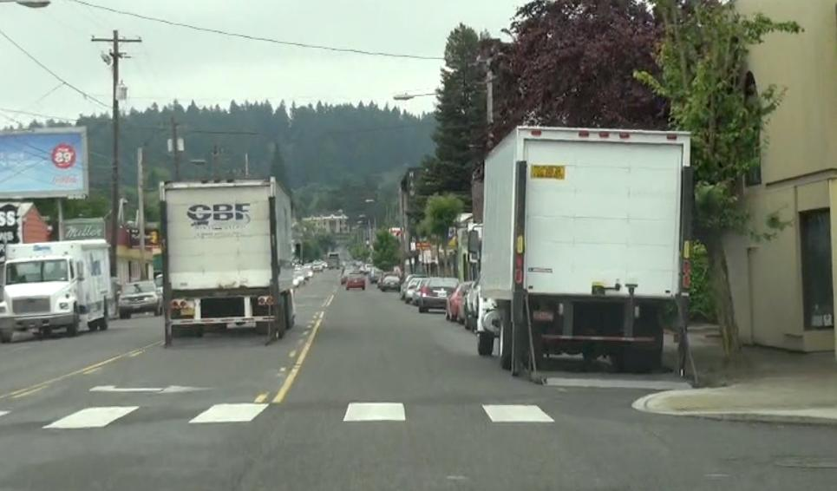
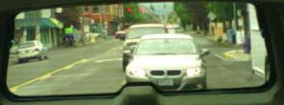
SOLVE
What zone should you check?
What is its condition?
Frederik R. Mottola©2013. Permission granted to Montana OPI.
Notes:
LOS and POT

Slide 31
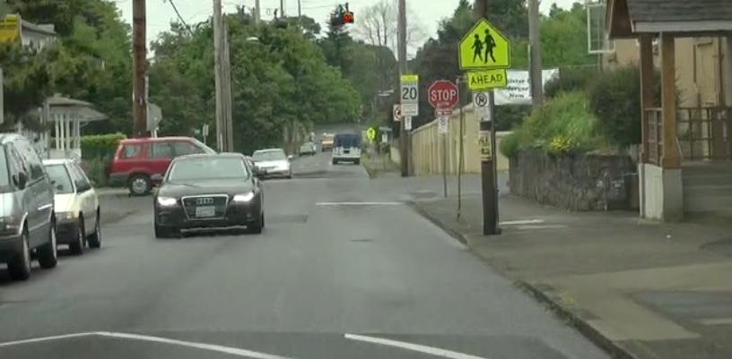
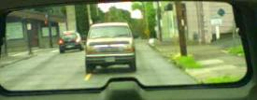
SOLVE
What other zones should you check?
What is their condition?
Frederik R. Mottola©2013. Permission granted to Montana OPI.
Notes:
There are many LOS and POT blockages in this photo
POT
Stop sign
Speed hump
Car coming at you
Intersection
Parked bus on the other side of the intersection
LOS
Cars on your left
Building on your right

Slide 32
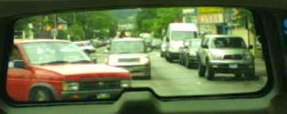
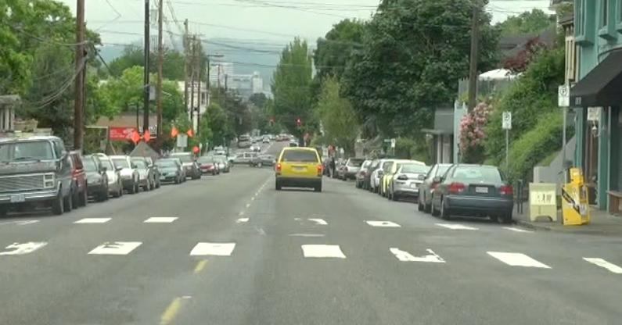
SOLVE
What zone should you check?
What is its condition?
Frederik R. Mottola©2013. Permission granted to Montana OPI.

Slide 33

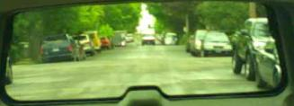
SOLVE
What other zone should you check?
What is its condition?
Frederik R. Mottola©2013. Permission granted to Montana OPI.

Slide 34
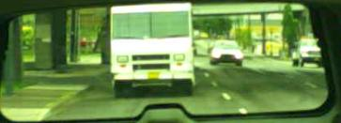
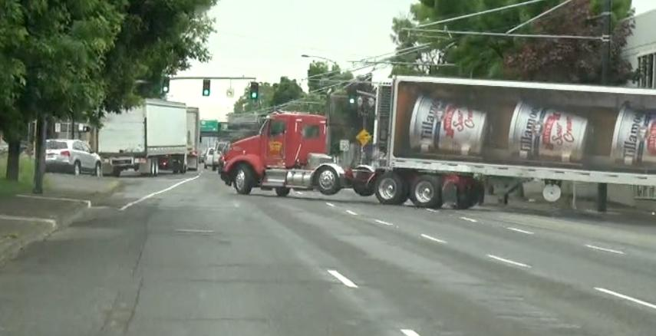
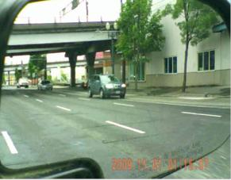
SOLVE
What other zones would you check?
What is their condition?
Frederik R. Mottola©2013. Permission granted to Montana OPI.

Slide 35
CONTROL
Within the 4-second danger zone
  Get best lane position to create space
  Get best speed control to create time
  Communicate your intentions
Frederik R. Mottola©2013. Permission granted to Montana OPI.
Notes:
The control piece of the zone control

Slide 36
Look at the following slides
You have done the Find and Solve
Now, determine your Control steps
  Lane Position
  Speed Control
  Communication
What can I do to create space and
give me more time?
Frederik R. Mottola©2013. Permission granted to Montana OPI.

Slide 37
CONTROL: Line-of-Sight and
Path-of-Travel Blockages
Lane Position, Speed Control and Communication options?
Frederik R. Mottola©2013. Permission granted to Montana OPI.
Notes:
LP 1, slow down, tap brakes

Slide 38

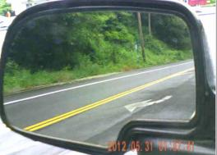
CONTROL - LOS and POT Blockages
Lane Position, Speed Control and Communication options?
Frederik R. Mottola©2013. Permission granted to Montana OPI.
Notes:
LP 1, slow down, tap brakes but make sure the car in the rear zone completes the lane change before you slow down. Why do you think that’s important?

Slide 39

CONTROL
Lane Position, Speed Control and Communication options?
Frederik R. Mottola©2013. Permission granted to Montana OPI.
Notes:
You don’t have adequate space to move to the left lane and cars are coming in on the right with someone passing you on the right. Best way to create space is to ease off the accelerator and to create space as the truck pulls away. You may also want to tap your brakes to indicate to the car in your rear zone that you are slowing some.

Slide 40
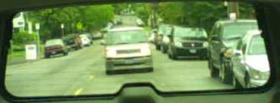
CONTROL
Lane Position, Speed Control and Communication options?
Frederik R. Mottola©2013. Permission granted to Montana OPI.
Notes:
LP 1, slow down, and tap brakes. The roadway forces you to get closer to the bicyclist as it narrows at the intersection. To continue to try to pass the cyclist at that point puts you too close. Create space and give yourself time by slowing down, allowing the cyclist to continue through the intersection and use the road design on the other side to take you away from the cyclist.

Slide 41
CONTROL
Lane Position, Speed Control and Communication options?
Frederik R. Mottola©2013. Permission granted to Montana OPI.
Notes:
Move to LP 2 foot off of accelerator (cover) and allow the hill to help you maintain speed—not increase speed. You could change lanes as well to create more space because your left rear zone is open.

Slide 42
CONTROL
Lane Position, Speed Control and Communication options?
Frederik R. Mottola©2013. Permission granted to Montana OPI.
Notes:
LP 2 gives you the most space between the trucks. You may want to even move to LP 1 after the first truck on the right. When you have only one lane position option you must slow down because you have no way to create space. Tap brakes to indicate to the rear that you are slowing.

Slide 43
CONTROL
Lane Position, Speed Control and Communication options?
Frederik R. Mottola©2013. Permission granted to Montana OPI.
Notes:
LP 3 to create space with the oncoming car, brake and brake lights to indicate slowing.

Slide 44
CONTROL
Lane Position, Speed Control and Communication options?
Frederik R. Mottola©2013. Permission granted to Montana OPI.
Notes:
LP 2 gives you space from the parked cars. Since there are no oncoming cars, you can avoid conflict with the parked cars by being in LP 2. If cars were coming toward you, what happens to your lane position options?
Foot off gas to begin slowing for light ahead and brake lights indicated by the yellow van. Tap brakes, monitor rear to make sure people behind are slowing.

Slide 45
CONTROL
Lane Position, Speed Control and Communication options?
Frederik R. Mottola©2013. Permission granted to Montana OPI.
Notes:
Setting up for a left turn on a one-way street, LP 2, slowing and foot on brake to stop the car.

Slide 46
CONTROL
Lane Position, Speed Control and Communication options?
Frederik R. Mottola©2013. Permission granted to Montana OPI.
Notes:
Your lane ends so you will need to move to the right lane. Since the truck blocks your lane, you need to move to LP 3 and initiate your lane change. You need to slow down because of the POT blockage and you need to signal to the right and tap your brakes at the same time to indicate your intentions.

Slide 47
Putting it all together
Watch the video on the following slide and:
FIND: Finding what is relevant
LOS and POT Blockages
SOLVE: Deciding my options to create more space and time
Checking related zones before acting
CONTROL: Putting my decisions into action
Lane position, speed control, communication
Frederik R. Mottola©2013. Permission granted to Montana OPI.
Notes:
Remember that the Zone Control System works because it is a continuous process that involves searching and scanning to find the closed zones, solving the blockage by checking related zones and then determining the best lane position, the best speed control and the best communication.

Slide 48
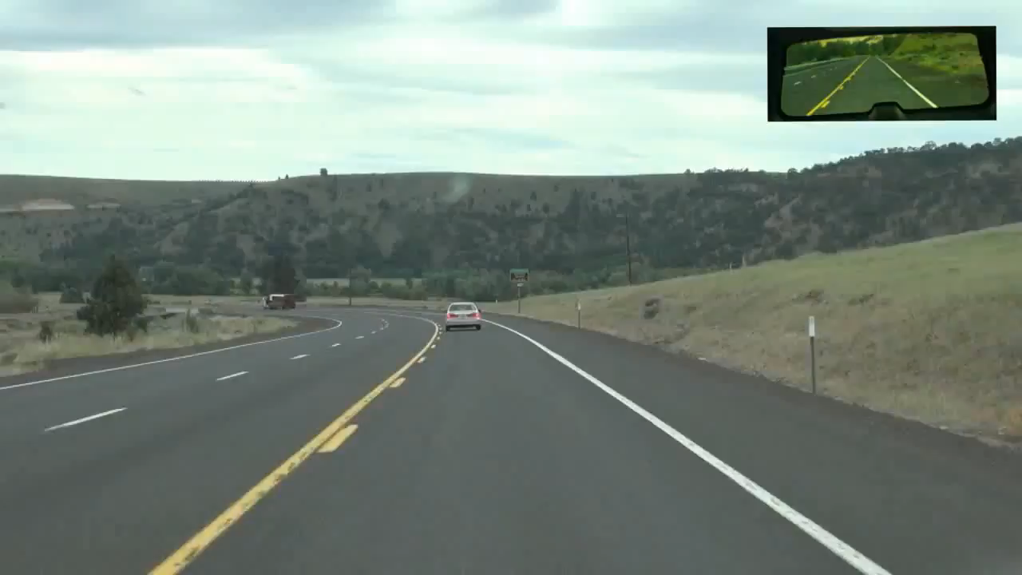
Now for some practice …
WATCH VIDEO
Notes:
What decisions is the driver having to make?

Slide 49
Montana Driver Education and Training
Standards and Benchmarks
1. Laws and Highway System
  1.1. know the laws outlined in the Montana Driver's manual;
  1.2. understand the laws outlined in the Montana Driver's Manual; and
  1.3. consistently demonstrate knowledge and understanding by responsible adherence to highway transportation system traffic laws and control devices.
2. Responsibility
  2.1. recognize the importance of making safe and responsible decisions for owning and operating a motor vehicle;
  2.2 demonstrate the ability to make appropriate decisions while operating a motor vehicle;
  2.3. consistently display respect for other users of the highway transportation system; and
  2.4. develop positive habits and attitudes for responsible driving.
3. Visual Skills
  3.1. know proper visual skills for operating a motor vehicle;
  3.2. communicate and explain proper visual skills for operating a motor vehicle;
  3.3. demonstrate the use of proper visual skills for operating a motor vehicle; and
  3.4. develop habits and attitudes with regard to proper visual skills.
4. Vehicle Control
  4.1. demonstrate smooth, safe and efficient operation of a motor vehicle; and
  4.2. develop positive habits and attitudes relative to safe, efficient and smooth vehicle operation.
5. Communication
  5.1. consistently communicate driving intentions (i.e., use of lights, vehicle position, and personal signals);
  5.2. adjust driver behavior based on observation of the highway transportation system and other roadway users;
  5.3. adjust communication (i.e., use of lights, vehicle position, and personal signals) based on observation of the highway transportation system and other users; and
  5.4. develop positive habits and attitudes for effective communication.
6. Risk Management
  6.1. understand driver risk-management principles;
  6.2. demonstrate driver risk-management strategies; and
  6.3. develop positive habits and attitudes for effective driver risk-management.
7. Lifelong Learning
  7.1. identify and use a range of learning strategies required to acquire or retain knowledge, positive driving habits, and driving skills for lifelong learning;
  7.2. establish learning goals that are based on an understanding of one’s own current and future learning needs; and
  7.3. demonstrate knowledge and ability to make informed decisions required for positive driving habits, effective performance, and adaptation to change.
8. Driving Experience
  8.1. acquire at least the minimum number of BTW hours over at least the minimum number of days, as required by law, with a Montana-approved driver education teacher; and
  8.2. acquire additional behind-the-wheel driving experience with a parent or guardian’s assistance in a variety of driving situations (i.e., night, adverse weather, gravel road, etc.).
Notes:
Standards and Benchmarks: This is for your reference and not to be read to the class verbatim. Please review prior to the lesson so you are aware of what the student will be required to know at the end of the module.

